Slide 1


Predictive maintenance using ML for printheads
Presented by: Anthony Atallah
Supervisor: M.Wolf Beat
Company representative: M.Fernando Rodriguez Llorente

Slide 2
Agenda
Context & problematic
Data + physics
Pipeline (ML)
Results + discussion

Slide 3
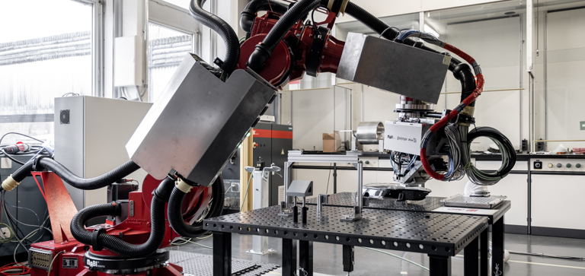
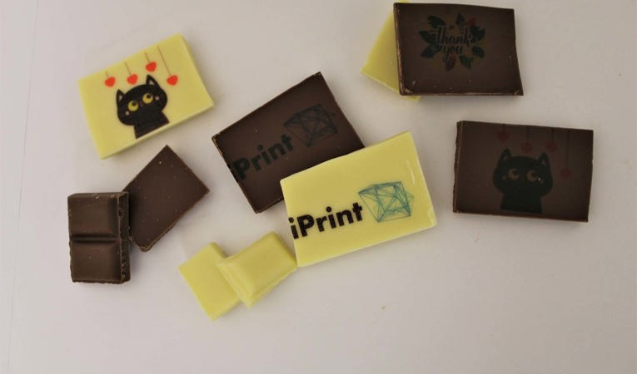
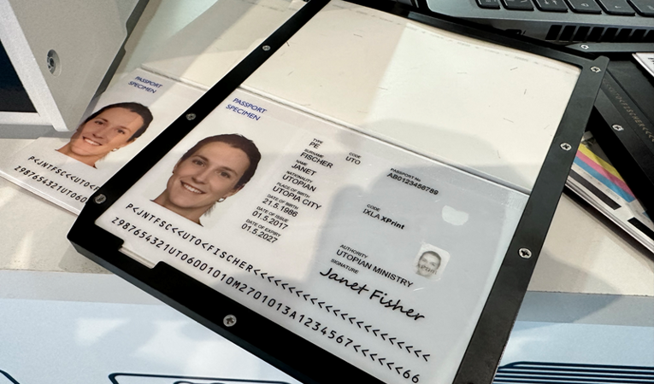
Context
Working with iPrint, leading research institute in 2D/3D printing technologies.

Slide 4
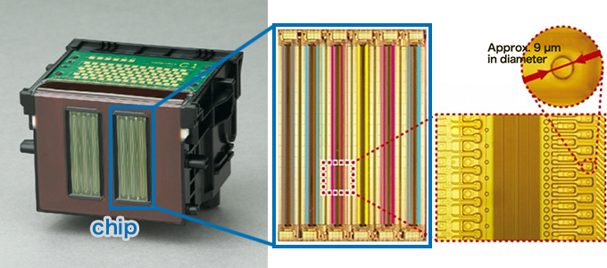
Printhead
Component in a printer that holds and transfer the ink to the printing medium
1280 nozzles separated into 4 electrical banks: A, B, C & D

Slide 5
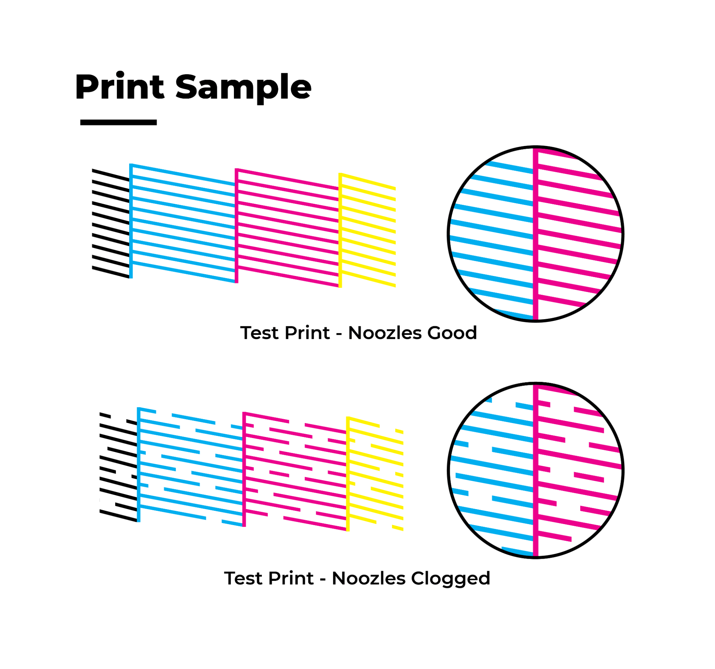
Problematic
Nozzle failures = print defects = cost/downtime
Current maintenance is reactive and depends on visual inspection or periodic cleaning.
Leverage signals for a proactive approach to maintenance.

Slide 6
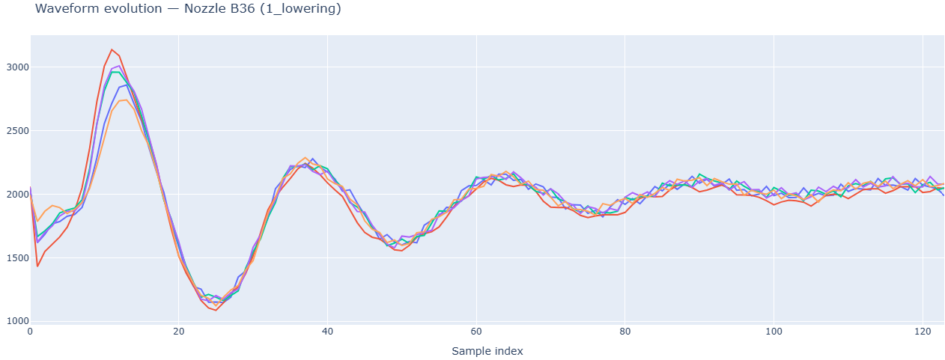
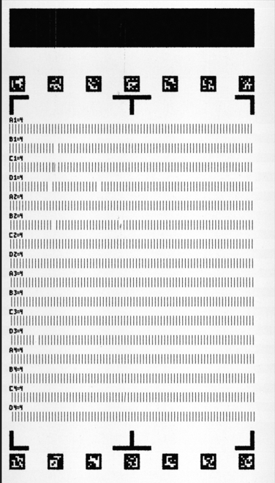
What we measure
Self-sensing waveform → nozzle dynamics
Nozzle-check image → label per nozzle

Slide 7
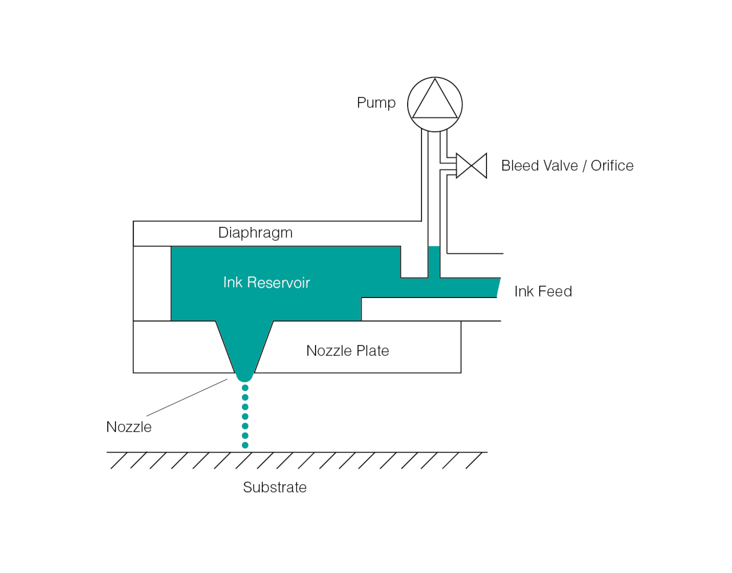
Self-sensing waveform
The same piezo element that actuates also senses ring-down via the direct piezoelectric effect.

Slide 8
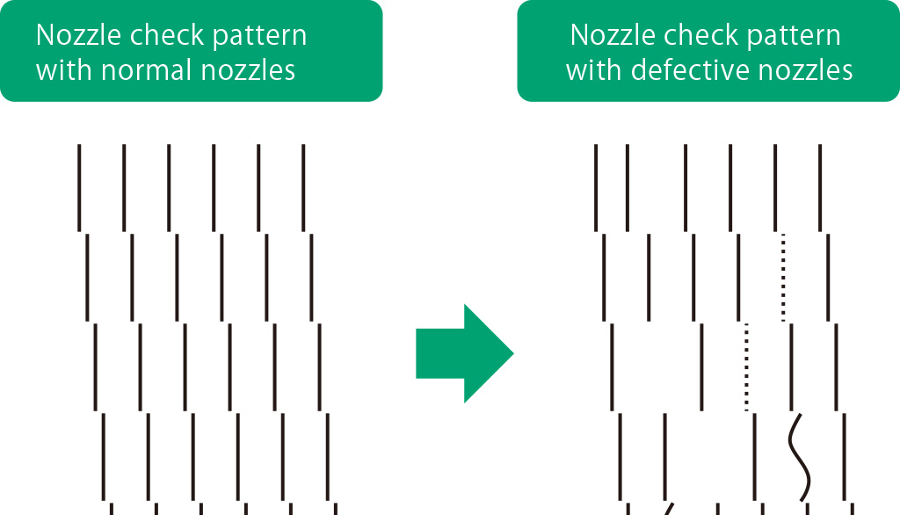
How labels are produced
Proprietary algorithm that segments and labels printed patterns
4 possible labels :
Jetting
Non-jetting
Intermittent
Deviated

Slide 9
Project scope
1. Relate signals to defect mechanisms
Explore link between applied pressure and acoustic signature.
2. Dynamic prediction of defects
Predict jetting status.
3. Proof-of-concept demonstrator
Input: acoustic data → Output: jetting status / early warnings.

Slide 10
Key contributions
Built preprocessing + parametric fitting pipeline
Trained/evaluated models across multiple test regimes
Identified defect dynamics + limitations

Slide 11
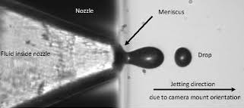
Controlled pressure sweeps to induce defects
Lowering sweep: −50 → −87.6 mbar (95 steps)
Increasing sweep: −50 → −46 mbar (11 steps)
Pressure = meniscus pressure (ink system vs atmosphere)
2 replicates per sweep: rep1 & rep2

Slide 12
Dataset: lowering replicate 1
1280 nozzles × 95 pressure levels = 121,600 labeled waveform instances for the main sweep

Slide 13
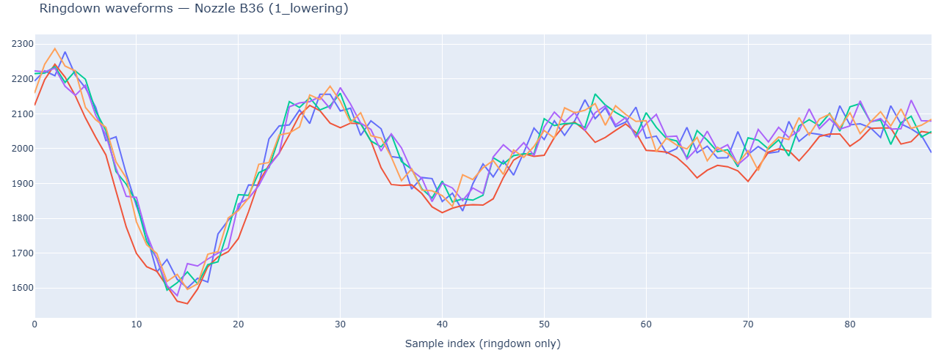
We keep the informative part only
First 35-time sample discarded:
Correspond to the saturated state after the actuation

Slide 14
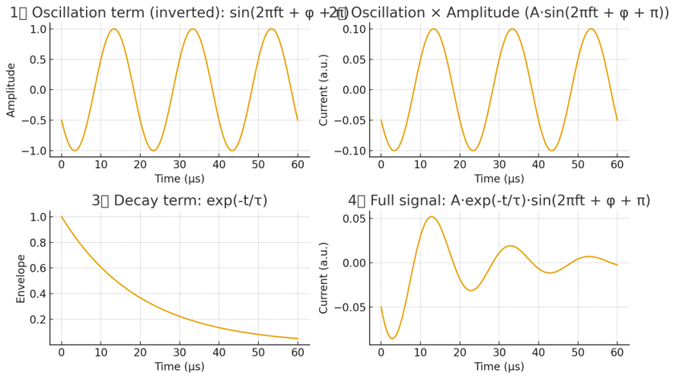
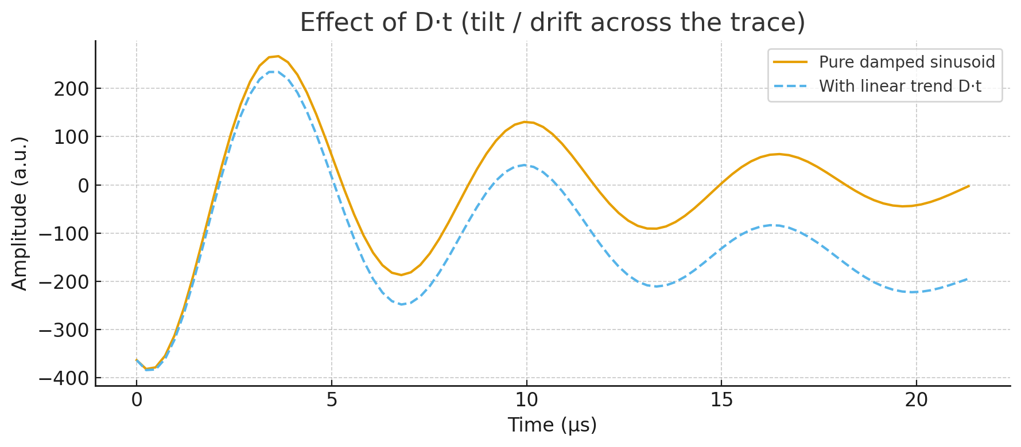
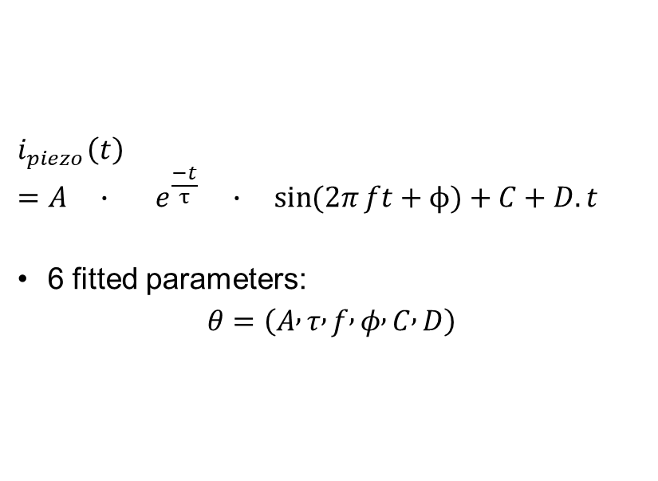
Compact, interpretable features
$$i_{piezo}\left(t\right)=A ∙ e^{\frac{−t}{τ}} ∙ \sin{(2π}ft+ϕ)+C+D.t$$
6 fitted parameters:
$$θ=\left(A , τ , f , φ , C , D\right)$$

Slide 15
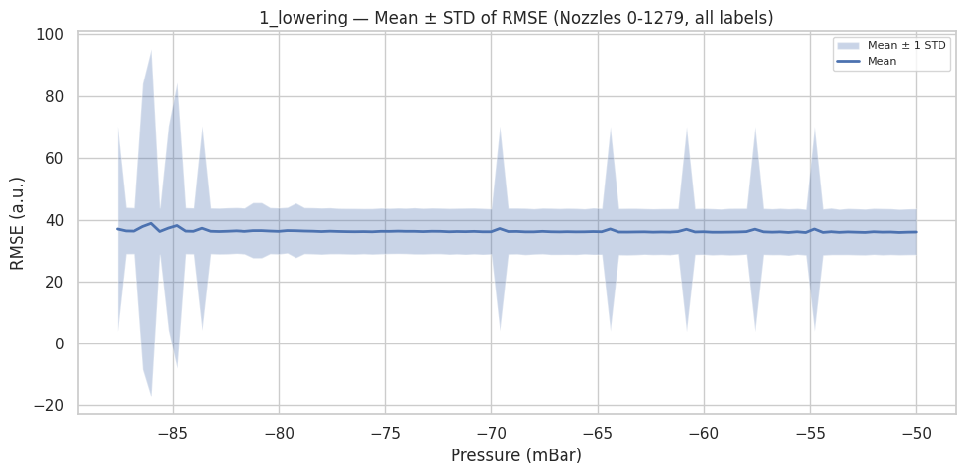
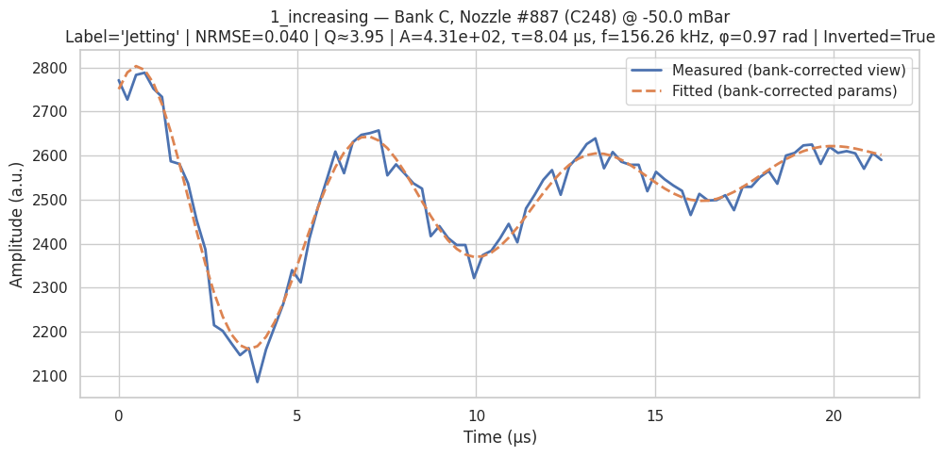
Robust fitting in 3 steps
Initial parameters estimates
Windowed least-square error fitting + overlap-add
Weighted average parameters

Slide 16
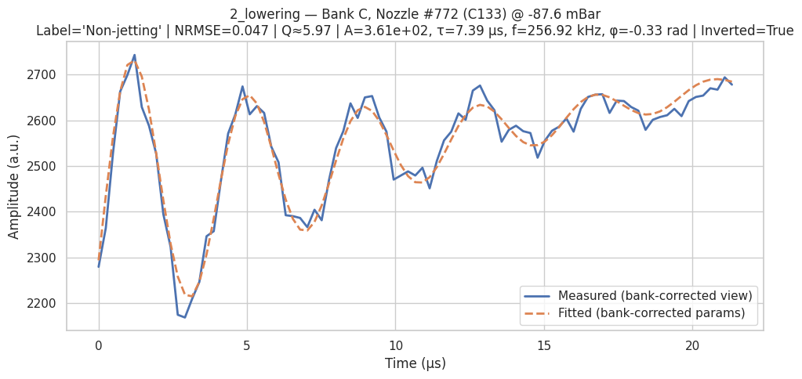
Fitting results

Slide 17
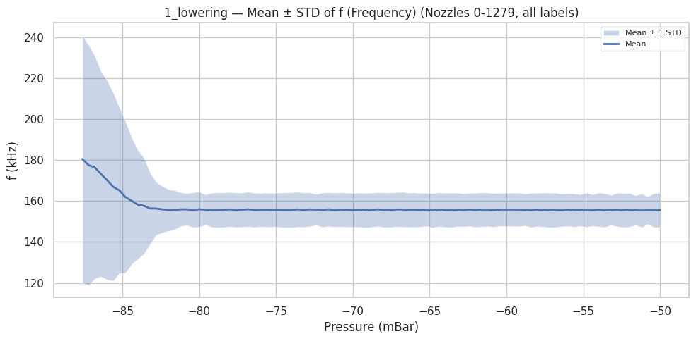
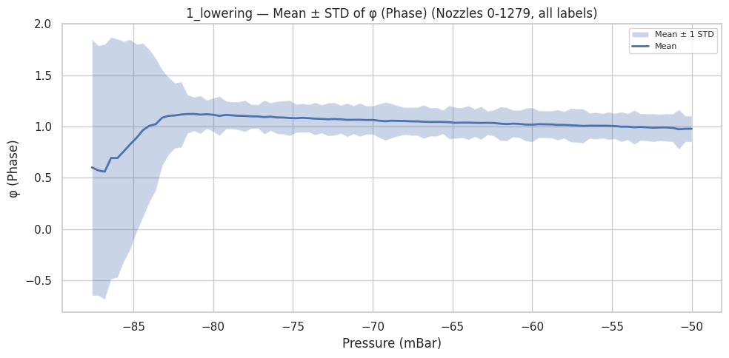
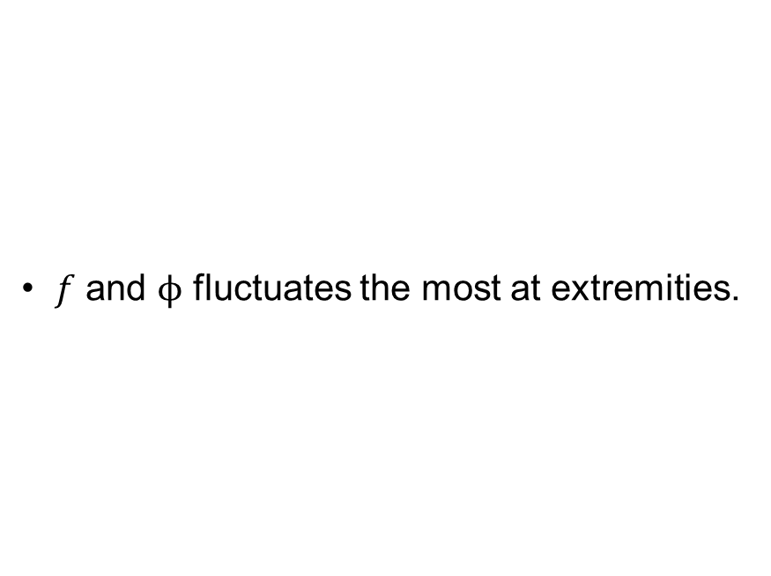
Parameters overview
$f$ and $ϕ$ fluctuates the most at extremities.

Slide 18
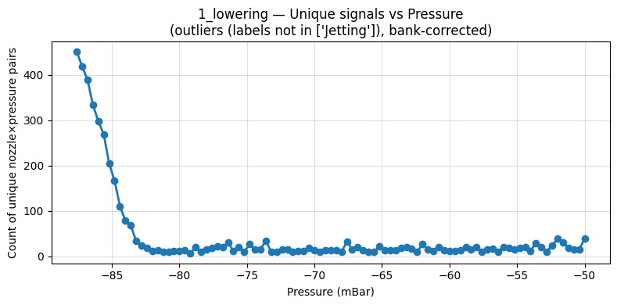
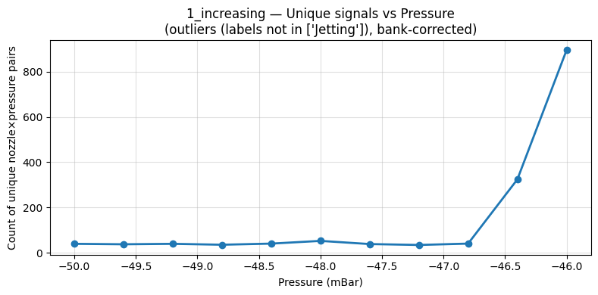
Defects concentrate at extremities
Dataset | Jetting | Non-jetting | Intermittent | Deviated
Lowering rep. 1 | 117,375 | 2,938 | 507 | 777
Increasing rep. 1 | 12,506 | 1,173 | 13 | 353

Slide 19
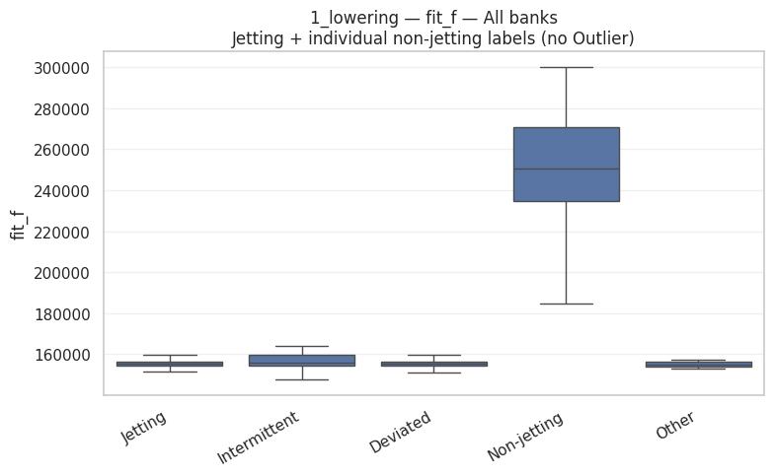
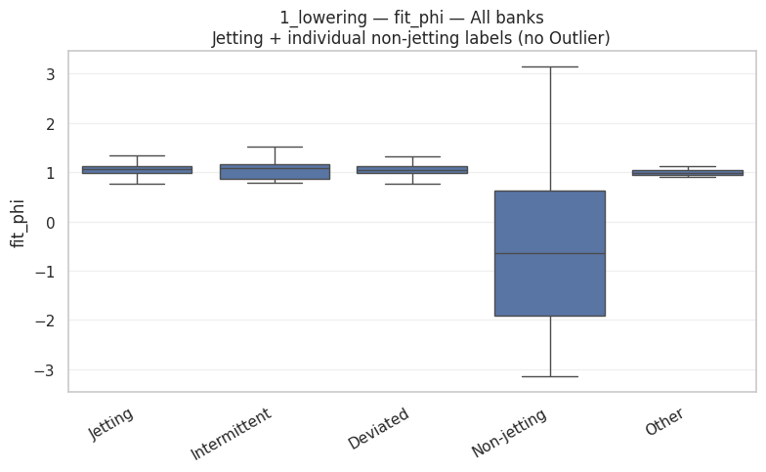
Parameters in function of labels
Boxplot midline represents the median.
Large difference between “Jetting” and “Non-jetting”

Slide 20
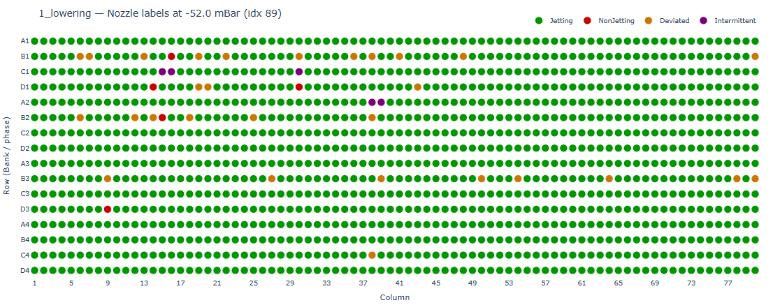
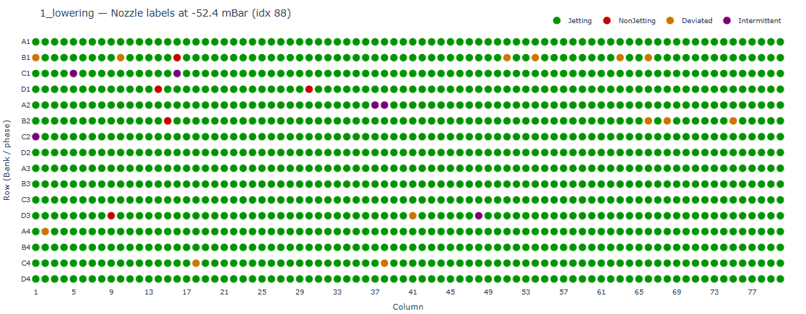
Binary labels for learning
Intermittent/deviated are unstable across steps.
We focus on the most reliable target: Jetting vs Non-jetting.

Slide 21
Experiments & results
3 tasks:
Classification: jetting vs non-jetting per (nozzle, pressure)
Pressure regression: predict pressure with parameters.
Predictive maintenance: “will this nozzle flip to non-jetting later?” lead time K

Slide 22
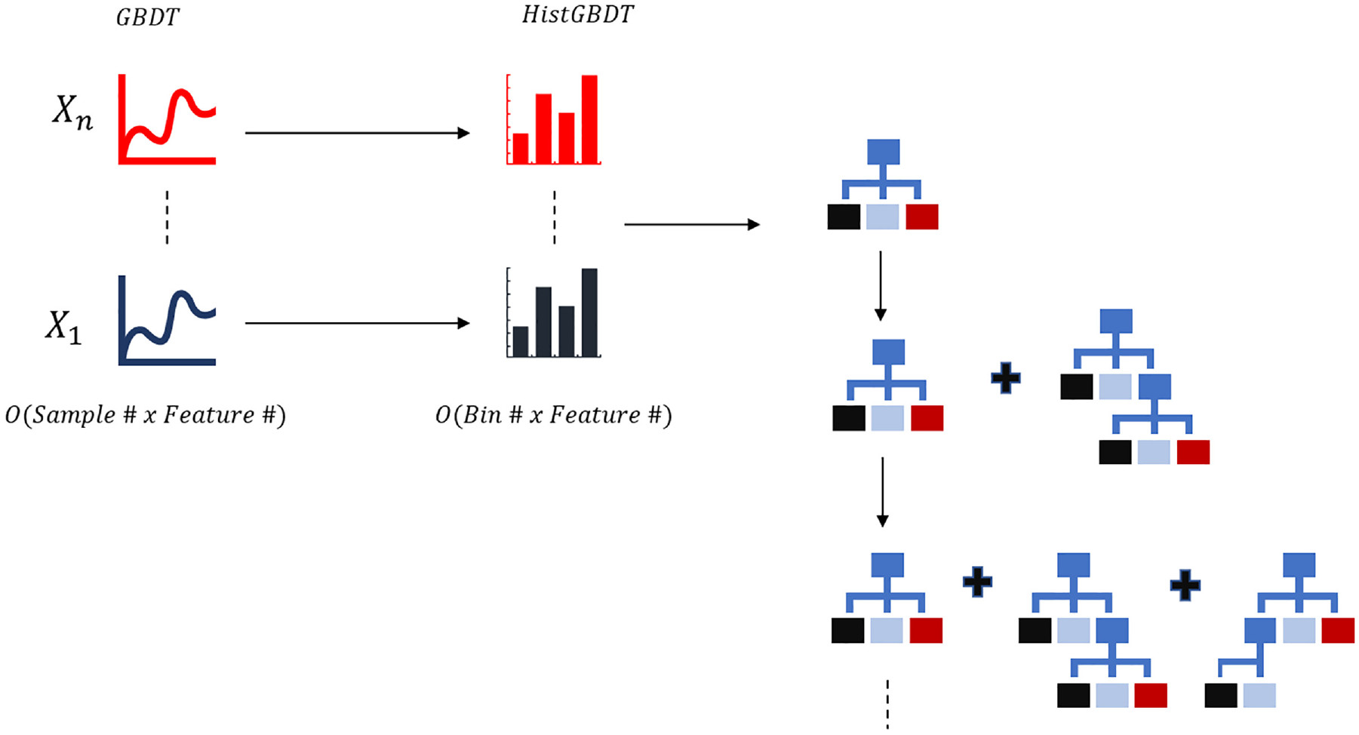
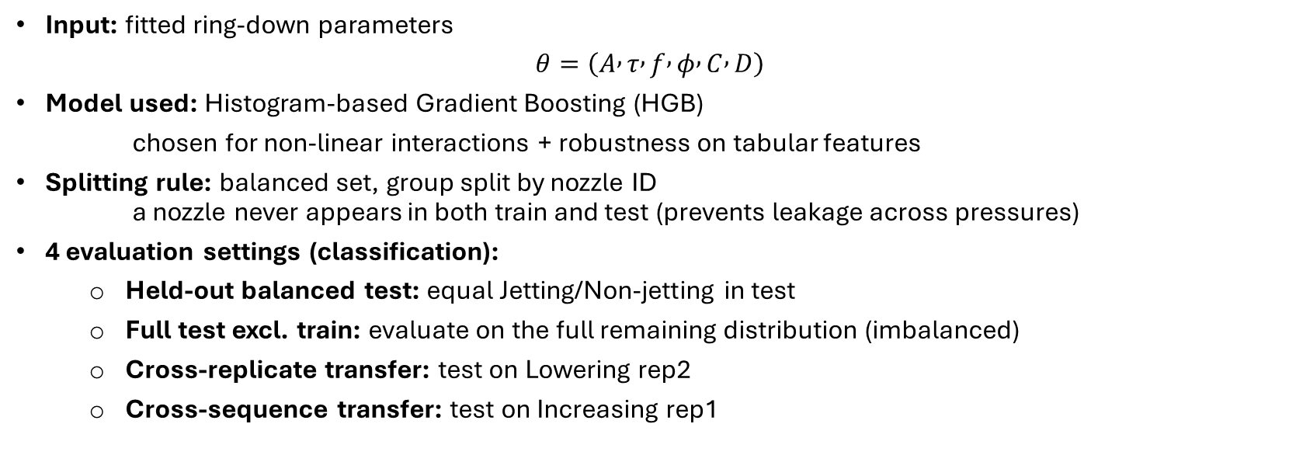
Classification model
Dataset | Jetting | Non-jetting
Lowering rep. 1 | 117,375 | 2,938
Input: fitted ring-down parameters
$$θ=\left(A , τ , f , φ , C , D\right)$$
Model used: Histogram-based Gradient Boosting (HGB)
chosen for non-linear interactions + robustness on tabular features
Splitting rule: balanced set, group split by nozzle ID a nozzle never appears in both train and test (prevents leakage across pressures)
4 evaluation settings (classification):
Held-out balanced test: equal Jetting/Non-jetting in test
Full test excl. train: evaluate on the full remaining distribution (imbalanced)
Cross-replicate transfer: test on Lowering rep2
Cross-sequence transfer: test on Increasing rep1

Slide 23
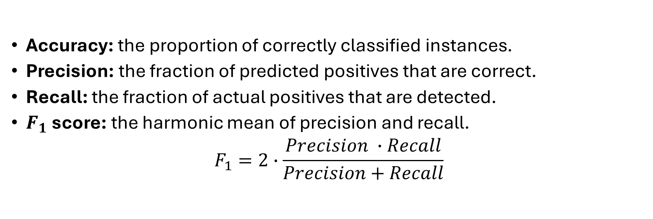
Metrics
Accuracy: the proportion of correctly classified instances.
Precision: the fraction of predicted positives that are correct.
Recall: the fraction of actual positives that are detected.
$F_{1}$ score: the harmonic mean of precision and recall.
$$F_{1}=2∙\frac{Precision ∙Recall}{Precision+Recall}$$

Slide 24
Classification: results
Detection is near-perfect on lowering sweeps and remains strong when changing replicate and trajectory.
Evaluation set | #Jetting | #Non-jetting | Accuracy | Precision | Recall | F1
Lowering rep. 1 (balanced test) | 501 | 501 | 0.99 | 1.0 | 0.99 | 0.99
Lowering rep. 1 (full excl. train) | 114,938 | 501 | 0.99 | 1.0 | 0.99 | 0.99
Lowering rep. 2 (full) | 116,837 | 3,139 | 0.99 | 1.0 | 0.99 | 0.99
Increasing rep. 1 (full) | 12,506 | 1,173 | 0.95 | 1.0 | 0.95 | 0.97

Slide 25
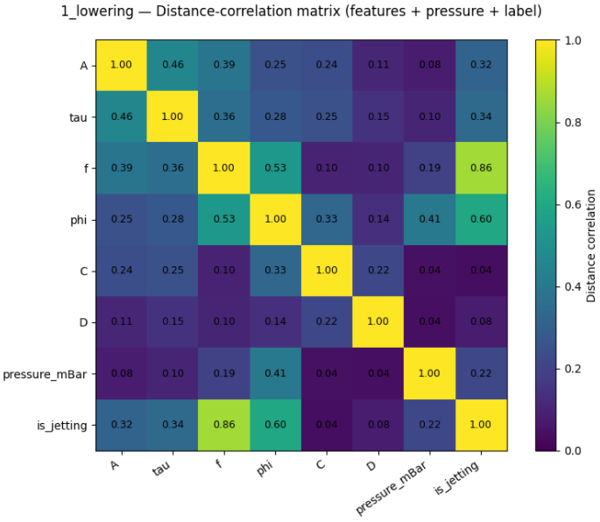
Classification: discussion
Label correlates strongly with oscillation parameters (f, φ).
Variable | Distance correlation with label
Frequency f | 0.86
Phase ϕ | 0.60
Meniscus pressure | 0.22
Defects are concentrated in the low-pressure tail → confounding risk → motivates pressure-matched evaluation.

Slide 26
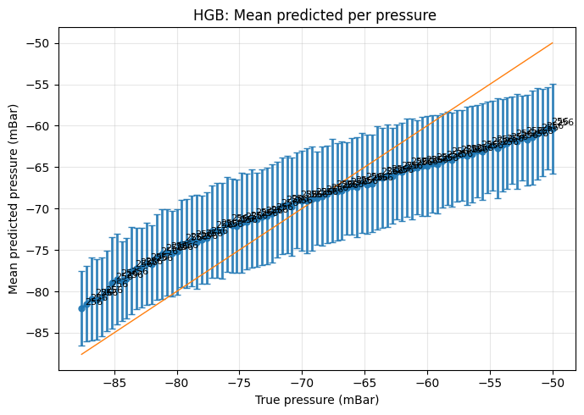
Pressure regression
Metric | Value
R² | 0.51
MAE | 6 mbar
RMSE | 7.7 mbar
Pressure can be predicted from the fitted parameters.

Slide 27
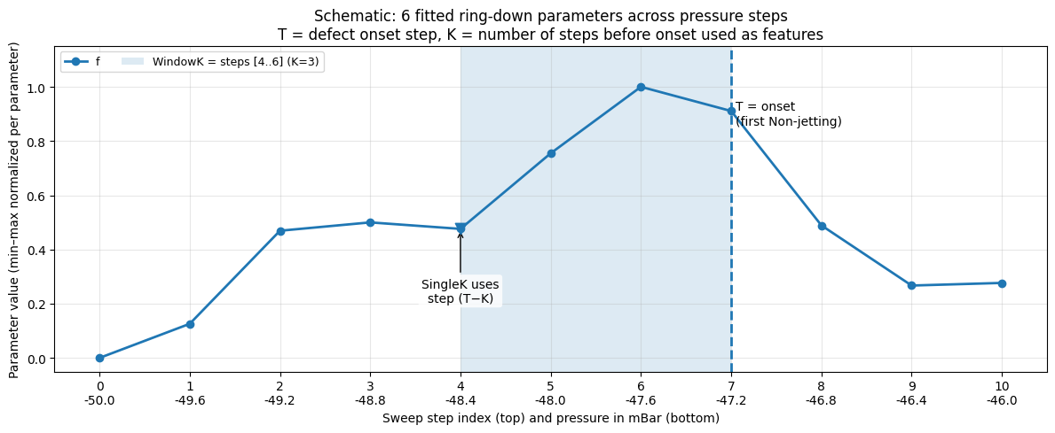
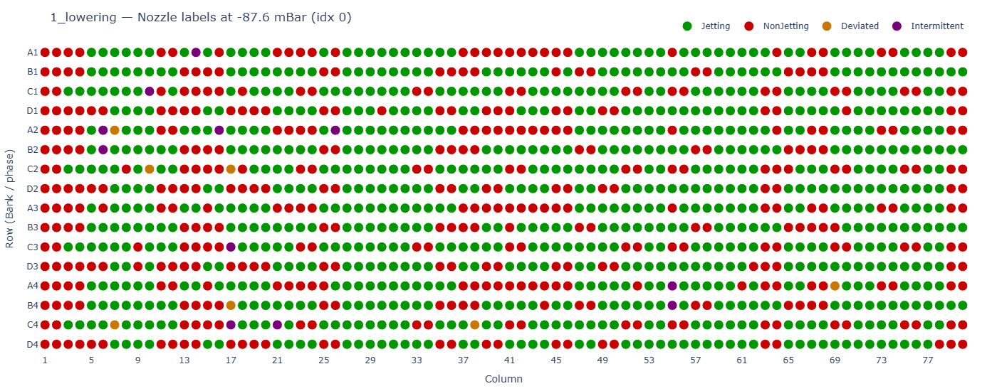
Predictive maintenance: model
Model used: Histogram-based Gradient Boosting (HGB)
Splitting rule: balanced set, split by nozzle ID
4 evaluation settings (classification)
Jetting=829 | Non-Jetting=433

Slide 28
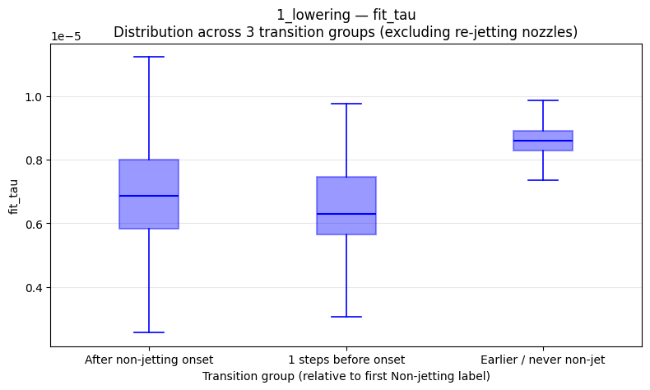
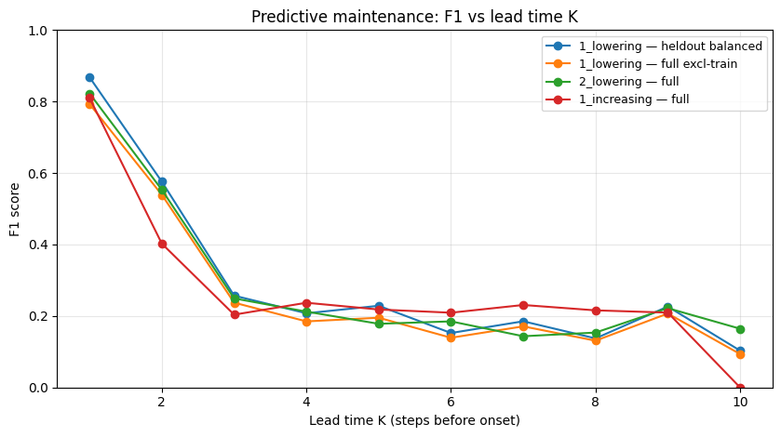
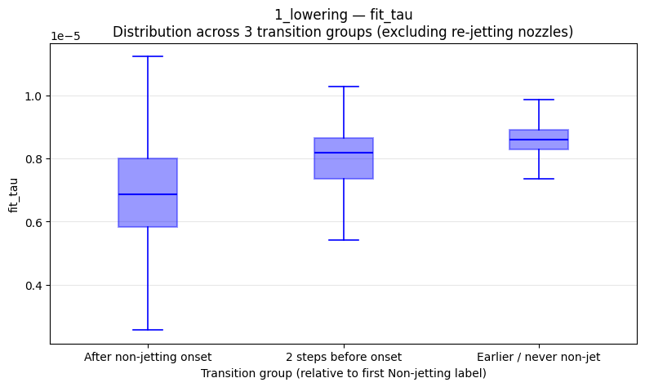
Predictive maintenance: results

Slide 29
Predictive maintenance: results
K | Dataset | #Won’t flip (0) | #Will flip (1) | Accuracy | Precision | Recall | F1
1 | Lowering rep. 1 (balanced) | 85 | 85 | 0.88 | 0.93 | 0.81 | 0.87
 | Lowering rep. 1 (full) | 170 | 85 | 0.86 | 0.78 | 0.81 | 0.79
 | Lowering rep. 2 (full) | 832 | 441 | 0.87 | 0.79 | 0.86 | 0.82
 | Increasing rep. 1 (full) | 538 | 713 | 0.76 | 0.75 | 0.88 | 0.81
2 | Lowering rep. 1 (balanced) | 85 | 85 | 0.67 | 0.81 | 0.45 | 0.58
 | Lowering rep. 1 (full ) | 170 | 85 | 0.75 | 0.68 | 0.45 | 0.54
 | Lowering rep. 2 (full) | 832 | 441 | 0.74 | 0.68 | 0.47 | 0.55
 | Increasing rep. 1 (full) | 538 | 713 | 0.52 | 0.69 | 0.29 | 0.40

Slide 30
Use-case
Input: self-sensing waveform (per nozzle)
Pre-process + fit parametric model
TRAIN MODEL WITH FITTED PARAMETERS
Output: K = 1 prediction

Slide 31
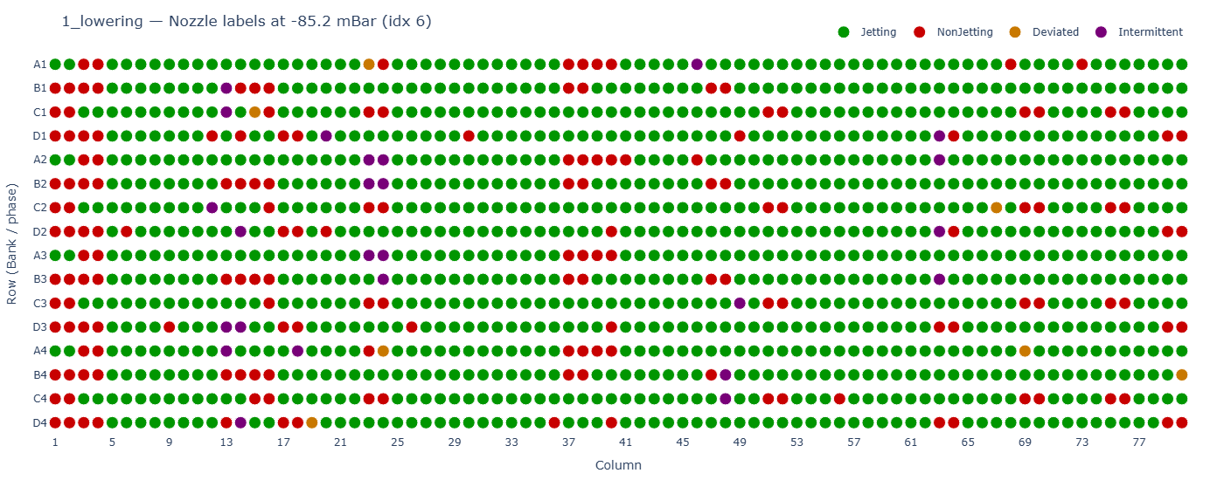
Limitations + next steps
Limitations:
Defects induced by pressure, not long-term wear
Binary labels only; intermittent/deviated excluded
Generalization to other printheads still to validate
Fitting doesn’t account for local variations
Next steps:
Collect stable-operation datasets (natural clogging/wear)
Richer representations e.g. spectrograms or neural embeddings
Add spatial context (column-aware models)

Slide 32
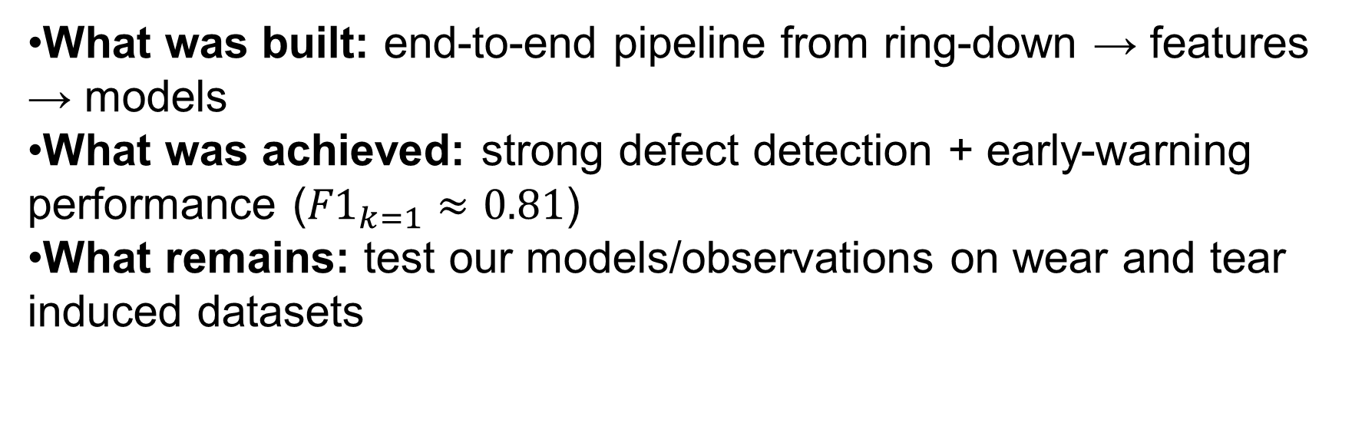
Conclusion
What was built: end-to-end pipeline from ring-down → features → models
What was achieved: strong defect detection + early-warning performance (${F1}_{k=1}≈0.81$)
What remains: test our models/observations on wear and tear induced datasets

Slide 33
Thank you for listening!

Slide 34
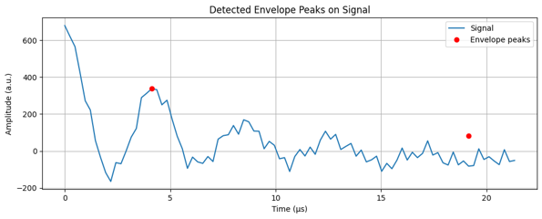
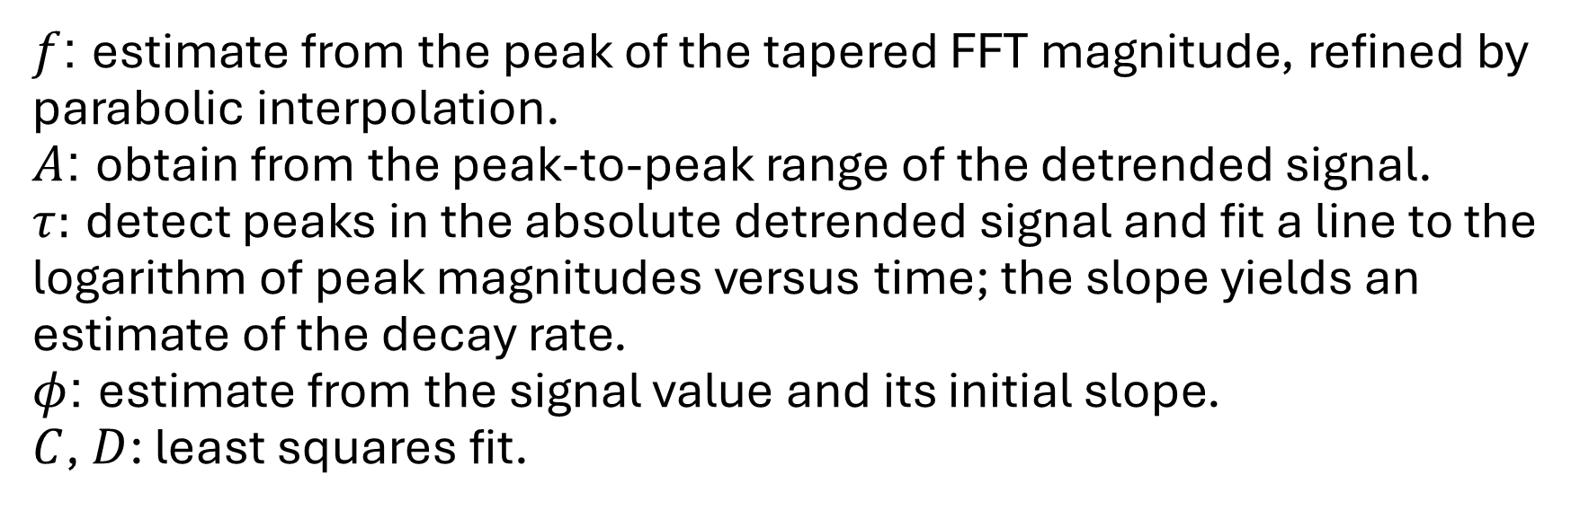
Annex: Parameter initialization
$f$: estimate from the peak of the tapered FFT magnitude, refined by parabolic interpolation.
$A$: obtain from the peak-to-peak range of the detrended signal.
$τ:$ detect peaks in the absolute detrended signal and fit a line to the logarithm of peak magnitudes versus time; the slope yields an estimate of the decay rate.
$φ$: estimate from the signal value and its initial slope.
$C$, $D$: least squares fit.

Slide 35
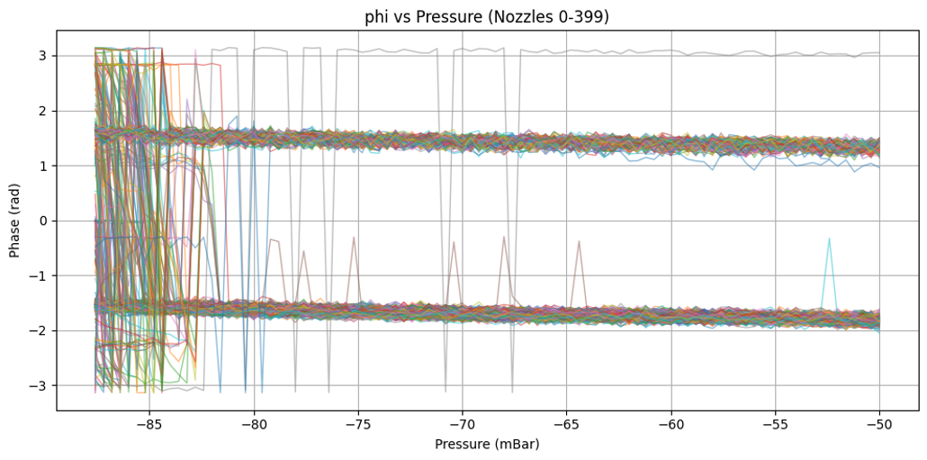
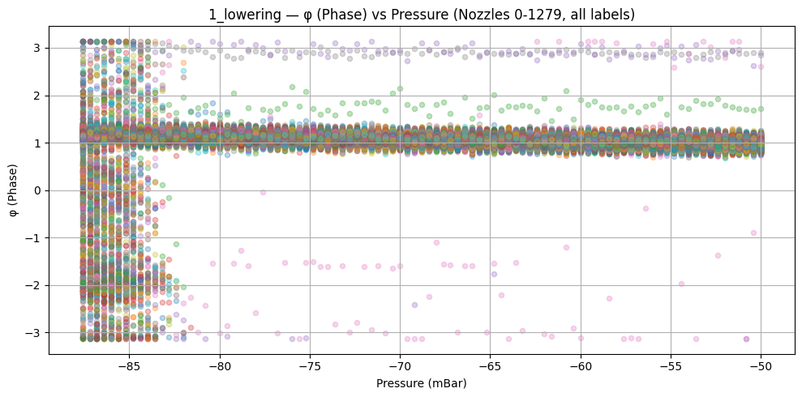
Annex: Bank phase correction

Slide 36
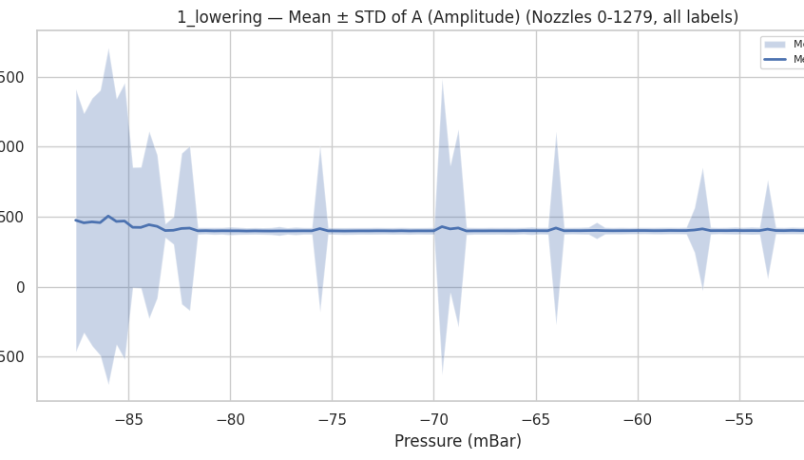
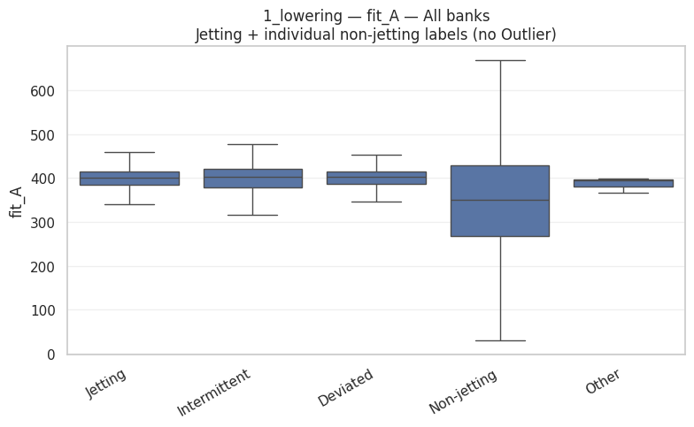
Annex: parameters

Slide 37
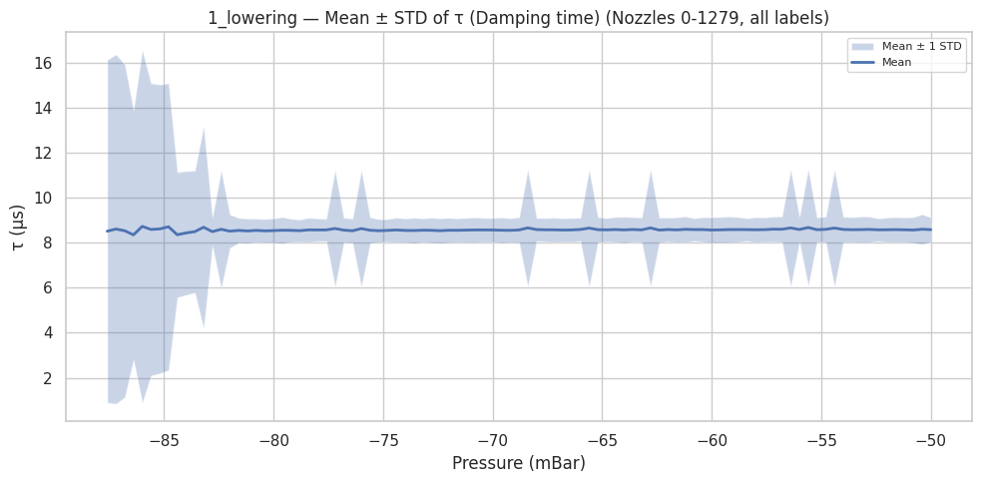
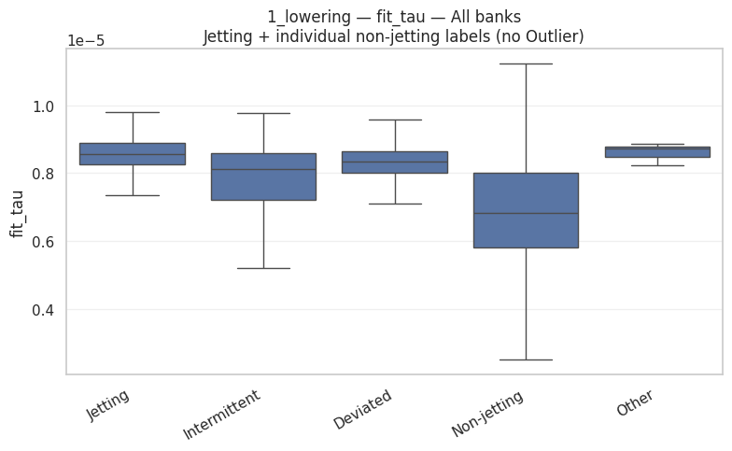
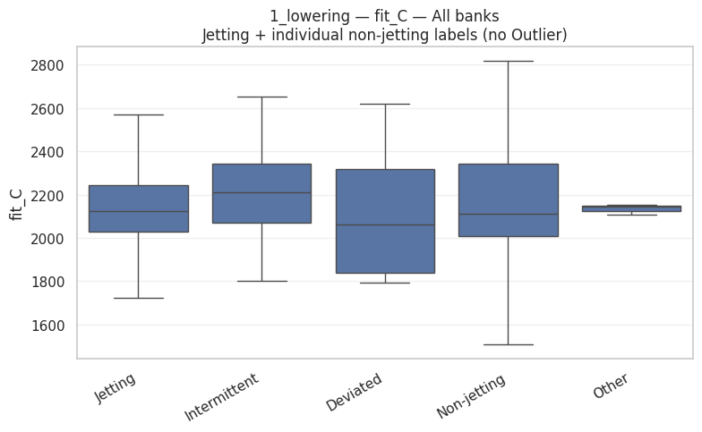
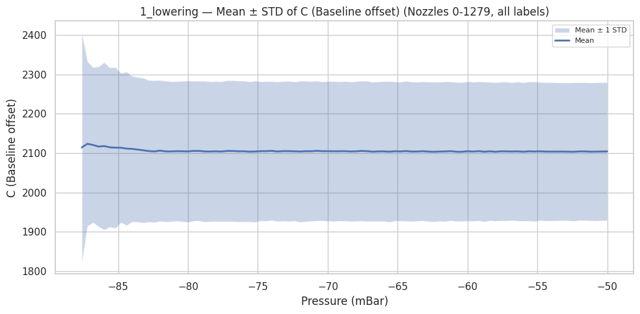
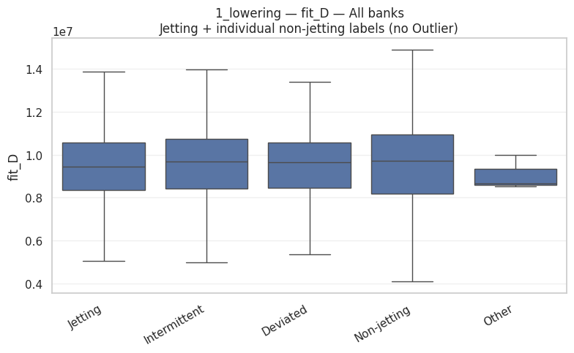
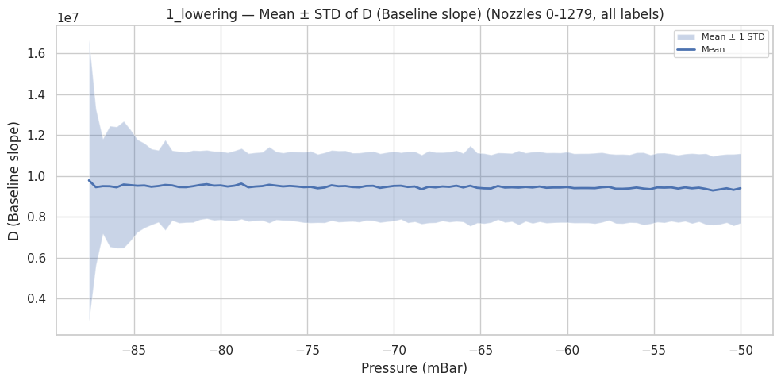
Annex: parameters

Slide 38

Annex: Distance correlation
A non-parametric measure of dependence that captures non-linear relationships between variables and is not sensitive to the scale of data.

Slide 39


Annex :Predictive maintenance

Slide 40

Annex : Gantt Chart

